Slide 1

CASE STUDY
Groundwater Modeling and Sustainability - the Great Nevada Water Battle
Norm Jones
Brigham Young University

Slide 2
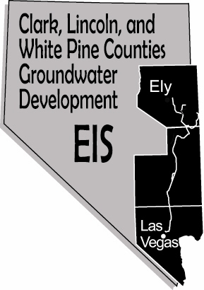
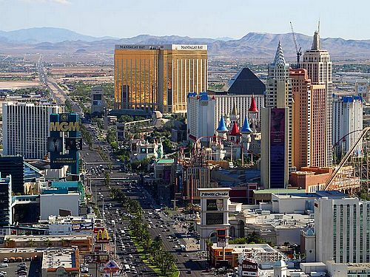

Background
28 wells (min)
306 miles of pipelines
5 pumping stations
Construction
2011-2022
Cost
$7B
$15B including financing costs
Notes:
Pat Mulroy – Head of SNWA

Slide 3

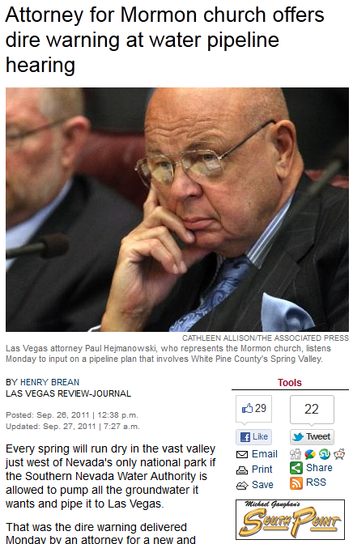
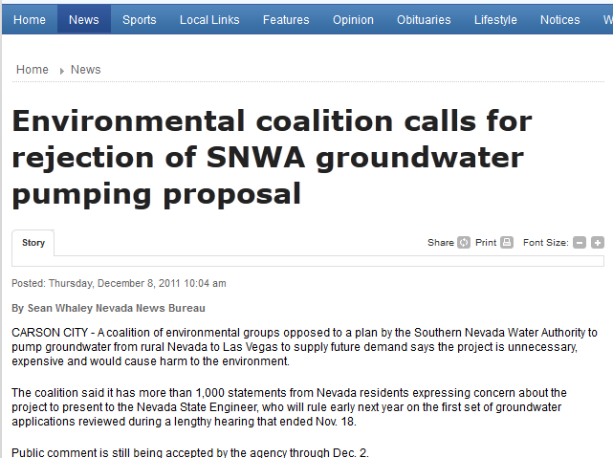
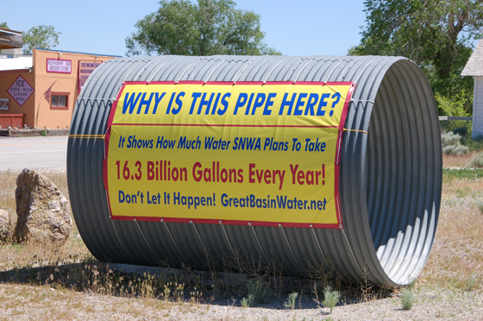
Opposition

Slide 4
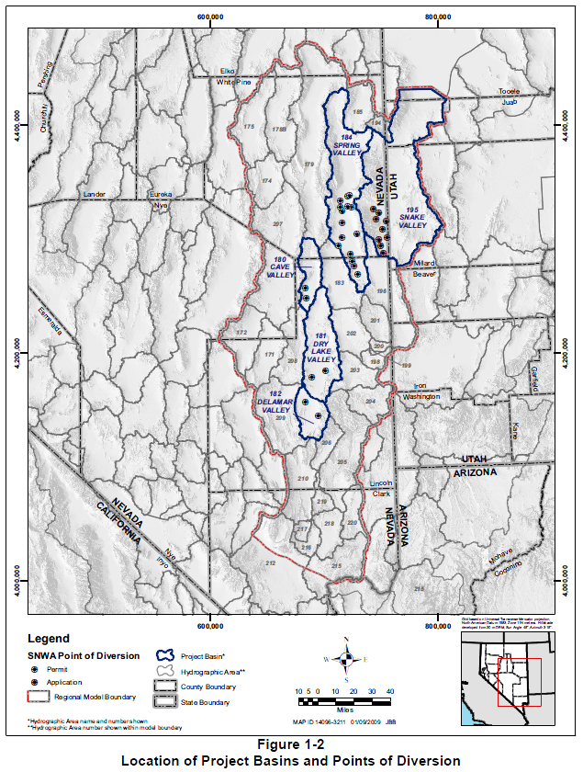
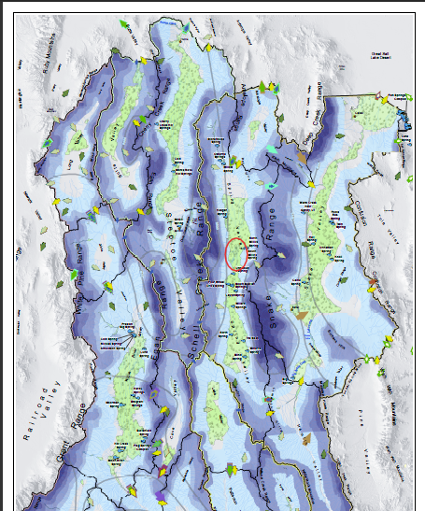
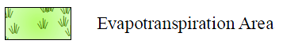
Project Location
Cleveland Ranch
Notes:
Conceptual Model of Groundwater Flow for the Central Carbonate-Rock Province: Clark, Lincoln, and White Pine Counties Groundwater Development Project, SNWA, November 2009.
Figure 1-2 and plate 1

Slide 5
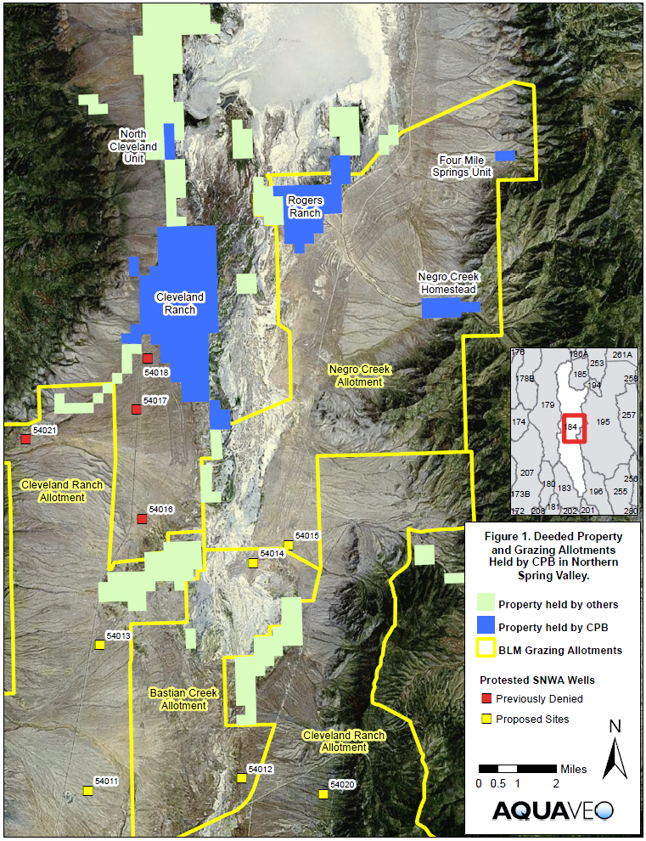
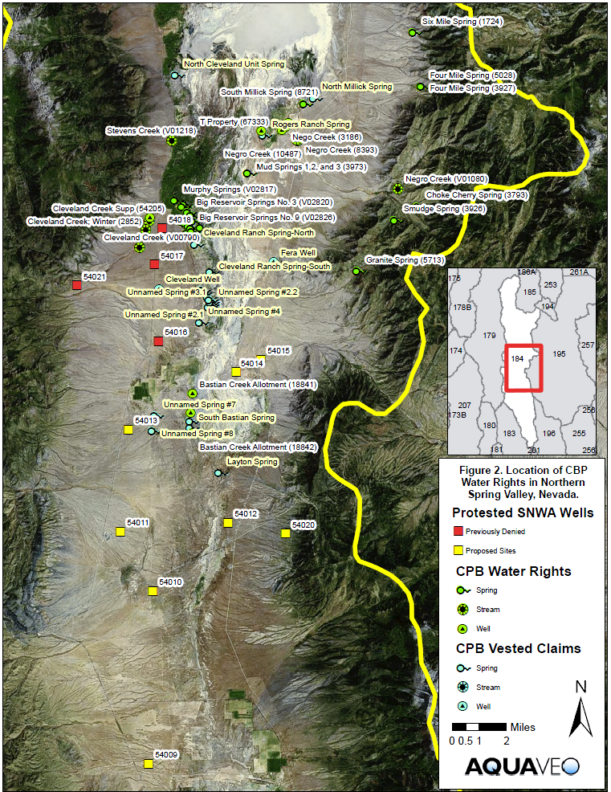
Cleveland Ranch

Slide 6
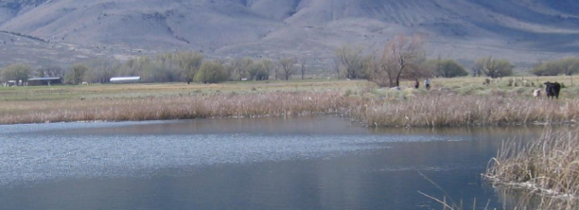
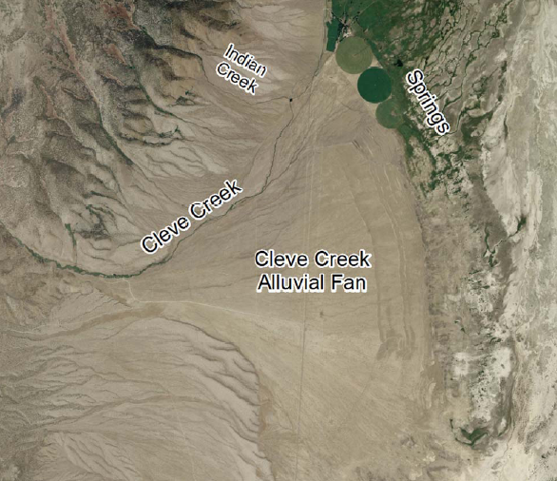
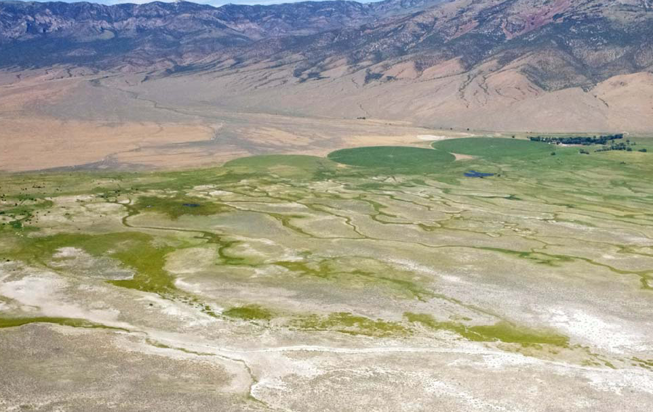
Hydrogeologic Setting

Slide 7
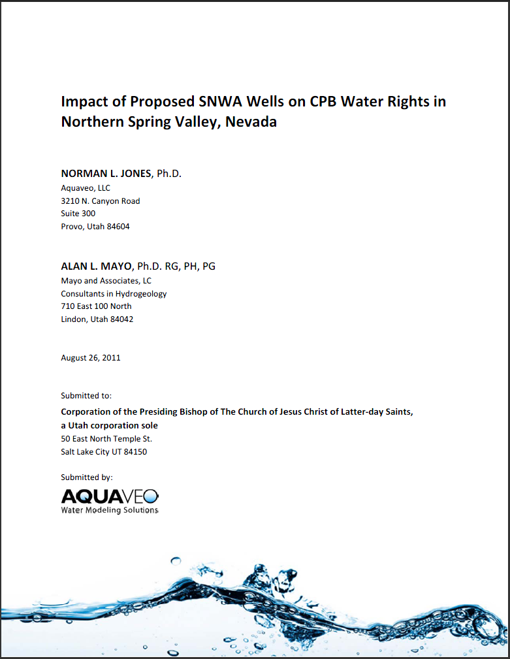
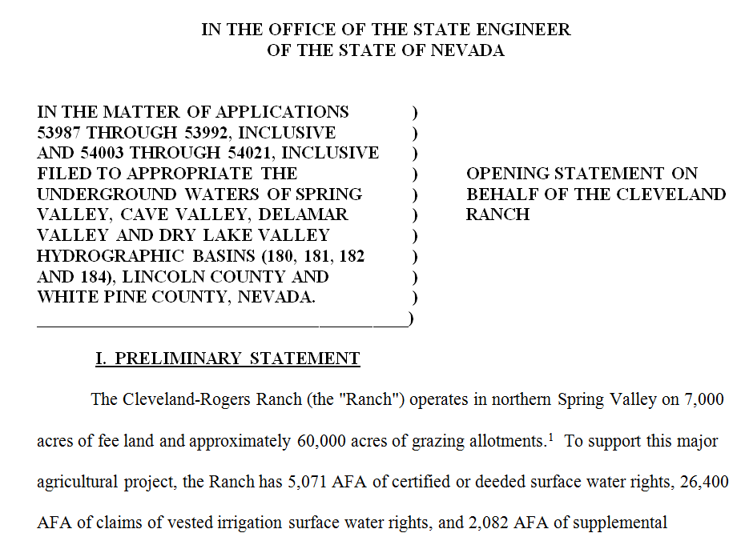
Cleveland Ranch
12 of 19 wells in Spring Valley protested by CPB
Formal protests filed by several other groups, including Great Basin Water Network

Slide 8
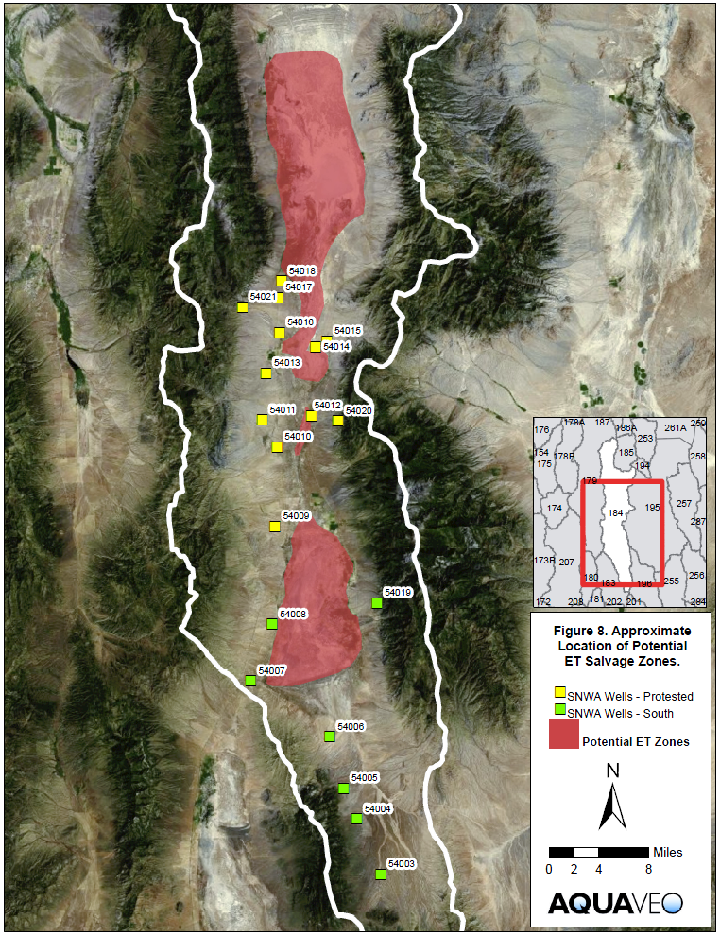
ET Salvage
Sustainable yield for valley based primarily on concept of ET salvage
Pumping system would draw down water table below ET extinction depth
Water currently lost to surficial discharge would be captured

Slide 9
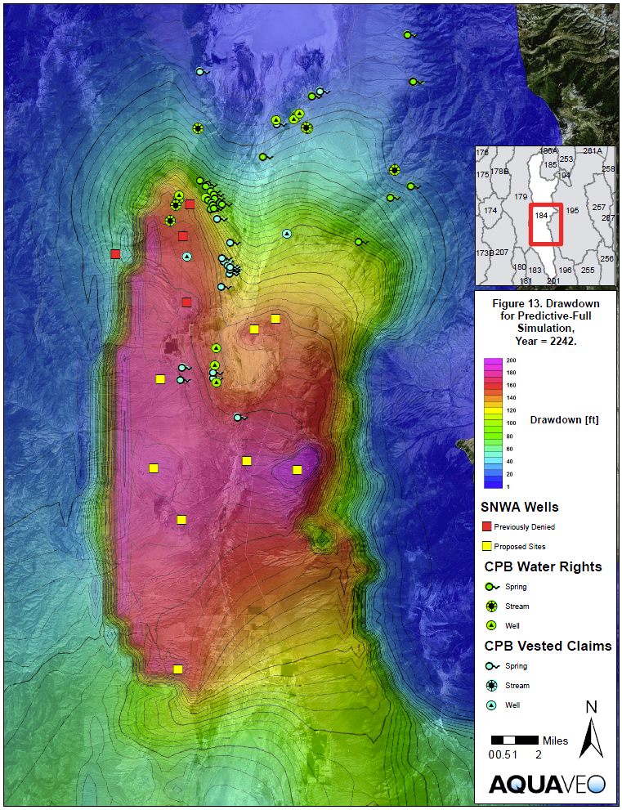
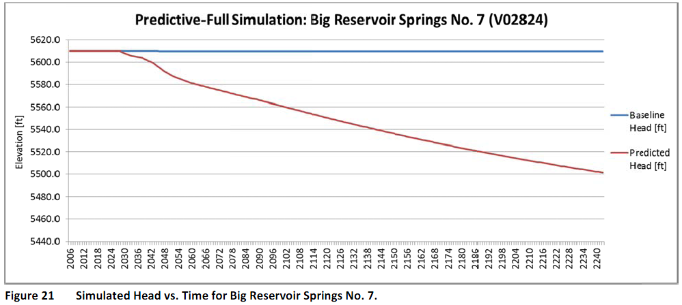
Model Simulated Drawdown

Slide 10
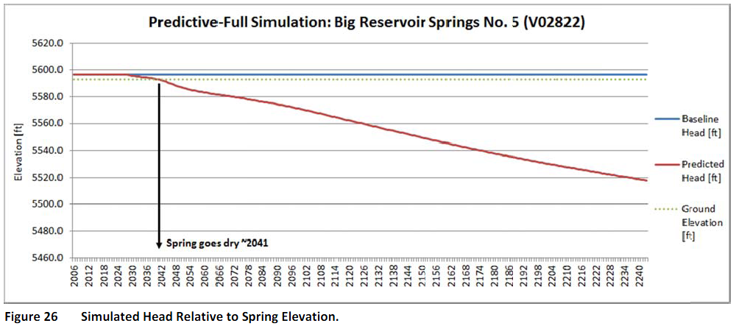
Impact on Springs

Slide 11
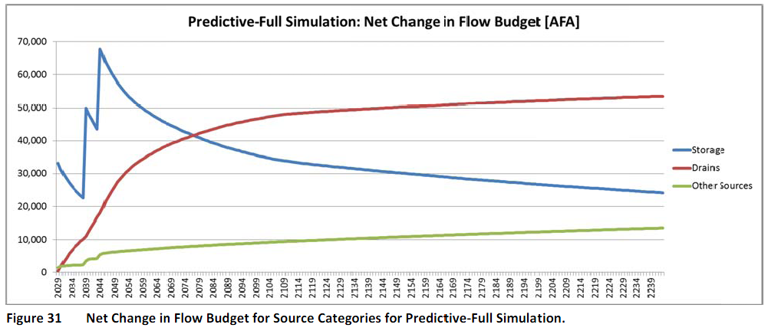
Groundwater Mining
At equilibrium, this line should go flat at 92,000 AFA
This line should go to zero
This is after 200 years of pumping!

Slide 12
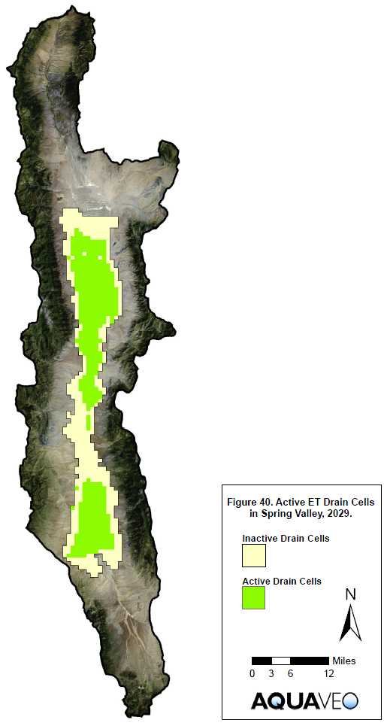
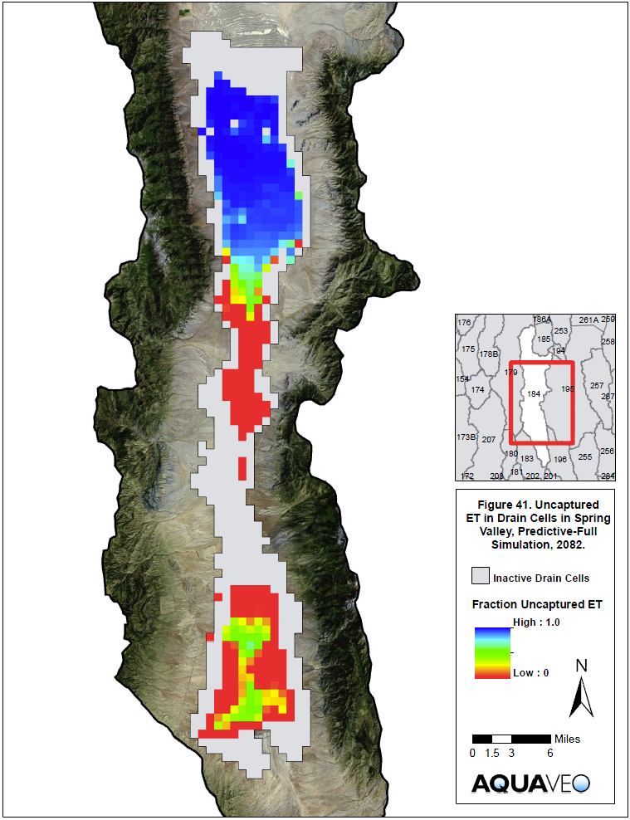
Incomplete ET Capture

Slide 13
2012 State Engineer Ruling
“The State Engineer finds that there is no requirement that the Applicant must show that the proposed well placement will actually be able to fully capture discharge. … There is no practical way to require them to manage their groundwater operations collectively to reach full capture. …
The State Engineer finds that the Applicant is not required to prove capture of ET as a prerequisite to approval of the Applications.”
Notes:
Top of page 91.

Slide 14
State Engineer Ruling
March 2012
Four wells in Cleve Creek alluvial fan denied
All other wells approved
Decision remanded on appeal in 2013

Slide 15
2013 District Court Remand Ruling
“The Engineer is correct that the time to reach equilibrium is not a valid reason to deny the grant of water, but
it may very well be a reason to limit the appropriation below the calculated E.T. Here, there is no valid evidence of when SNWA will capture E.T., if ever.” - Pg 11
“The Engineer 's finding that equilibrium in Spring Valley water basin will "take a long time" was not based on substantial or reliable evidence, and is incorrect. Indeed, by his own statements - and evidence - equilibrium will never be reached.” - Pg 12
Notes:
- After reviewing these definitions and the evidence presented from all sides in the hearings and appeals in 2011 and 2012, Judge Estes came to the following conclusions in the District Court remand ruling.
(READ STATEMENTS)
- This conclusion is consistent with what I explained on the previous slide. If equilibrium is not reach, we do not have transitional storage resulting from the migration from one state to another state. We have perpetual groundwater mining, which is explicitly forbidden in Nevada.
- The NSE and SNWA argued that time to equilibrium should not matter because it can take a very long time. It is true that it can take a long time.
- The NSE is correct that demanding that a basin equilibrates after the addition of a new stress (well) in a short time period puts an unreasonable burden on water managers. For example, suppose you apply for a new appropriation associated with a small well at some distance from a discharge zone. It very well could be that it would take centuries for the system to equilibrate. That is most likely the case for most small wells in big basins. If you select an arbitrary short response time, the NSE would have to reject almost all applications.
- So I think a better argument is whether or not a long time frame is excessive depends on the risk and impacts and should be handled on a case-by-case basis. With my small well example, it may take centuries to come to equilibrium, but it may only remove a small amount of transitional storage in the process. But with a large appropriation distant from the source of water, it may come to equilibrium in several centuries but dewater the aquifer in the process.
- So the time to equilibrium is critically important in two conditions:
1) The time to equilibrium is so long and the removal from storage is so large that it results in all the negative impacts of GW mining as explained earlier.
2) There is strong evidence that the system will NEVER reach equilibrium.
- Judge Estes correctly recognized a simple logical fallacy: You cannot on the one hand state that GW mining is forbidden while at the same time claiming that ET capture and equilibrium do not matter. If equilibrium is not achieved, you will have groundwater mining. This simple bit of common sense is enshrined in the NSE own definition of PY as we saw at the beginning of this presentation.
- As a result of this, Judge Estes concluded as follows: (NEXT SLIDE)

Slide 16
2017 Hearings in Response to Remand Ruling

Slide 17
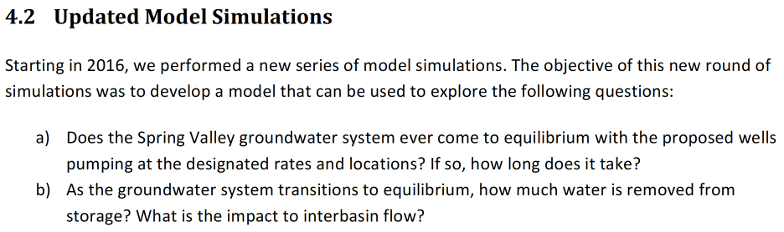
Using the same groundwater model used by the SNWA experts, we performed a 2000-yr simulation to see if the system EVER comes to equilibrium.
Total permitted rate was reduced to 61K AFA by State Engineer
Notes:
- In order to respond to remand ruling directive #2, we performed a series of simulations using an updated version of the SNWA CCRP model
- In the first of simulations, our objectives were to:
(READ OBJECTIVES A&B)

Slide 18
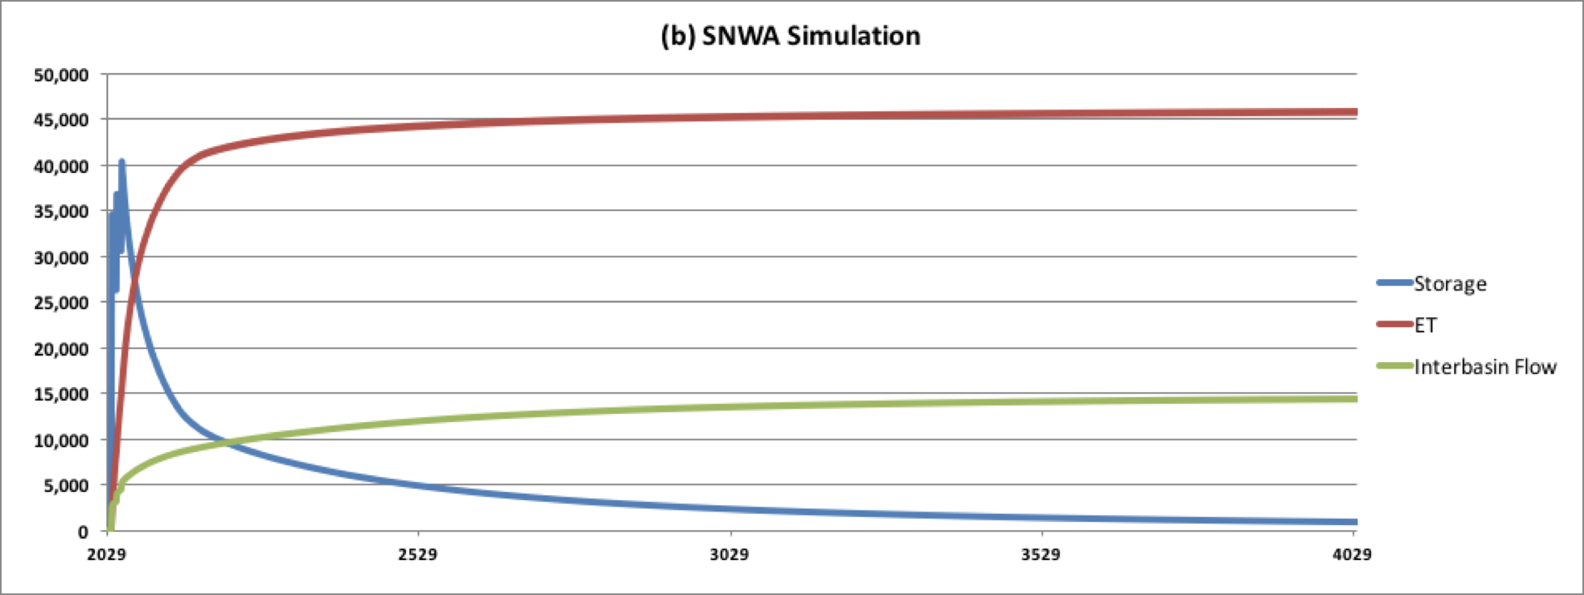
Results - Net Change in Flow Budget
This goes flat, but well short of 61K AFA
Balance is made up by drawing water from adjacent basins!
This eventually approaches zero
Notes:
- The first thing we did was analyze the net flow budget for the model. Again, the “net change” means that this is the difference between the results from the predictive simulation with the SNWA wells and the baseline simuation without the wells. I.e., this is the net impact of the project on the GW basin.
- There are four main components to the flow budget:
Pumping
ET Capture
Change in Storage
Interbasin flow
- This chart does not include pumping, but it does include the other three components. At any point in the graph following full development (after the staged development), the sum of the storage, ET capture, and interbasin flow sum to the total pumping rate: 61K AFA.
- EXPLAIN CHART
- ET CAPTURE FLATLINES AT 45K AFA (~75%)
- STORAGE (~0 after 2000 years)
- INTERBASIN FLOW 15K AFA (~25%)
- One of the significant findings from these results is the change in interbasin flow. This is a positive value which means that there is a net inflow from adjacent basins to Spring Valley.
- So essentially, interbasin flow can be thought of as groundwater mining from adjacent basins.

Slide 19
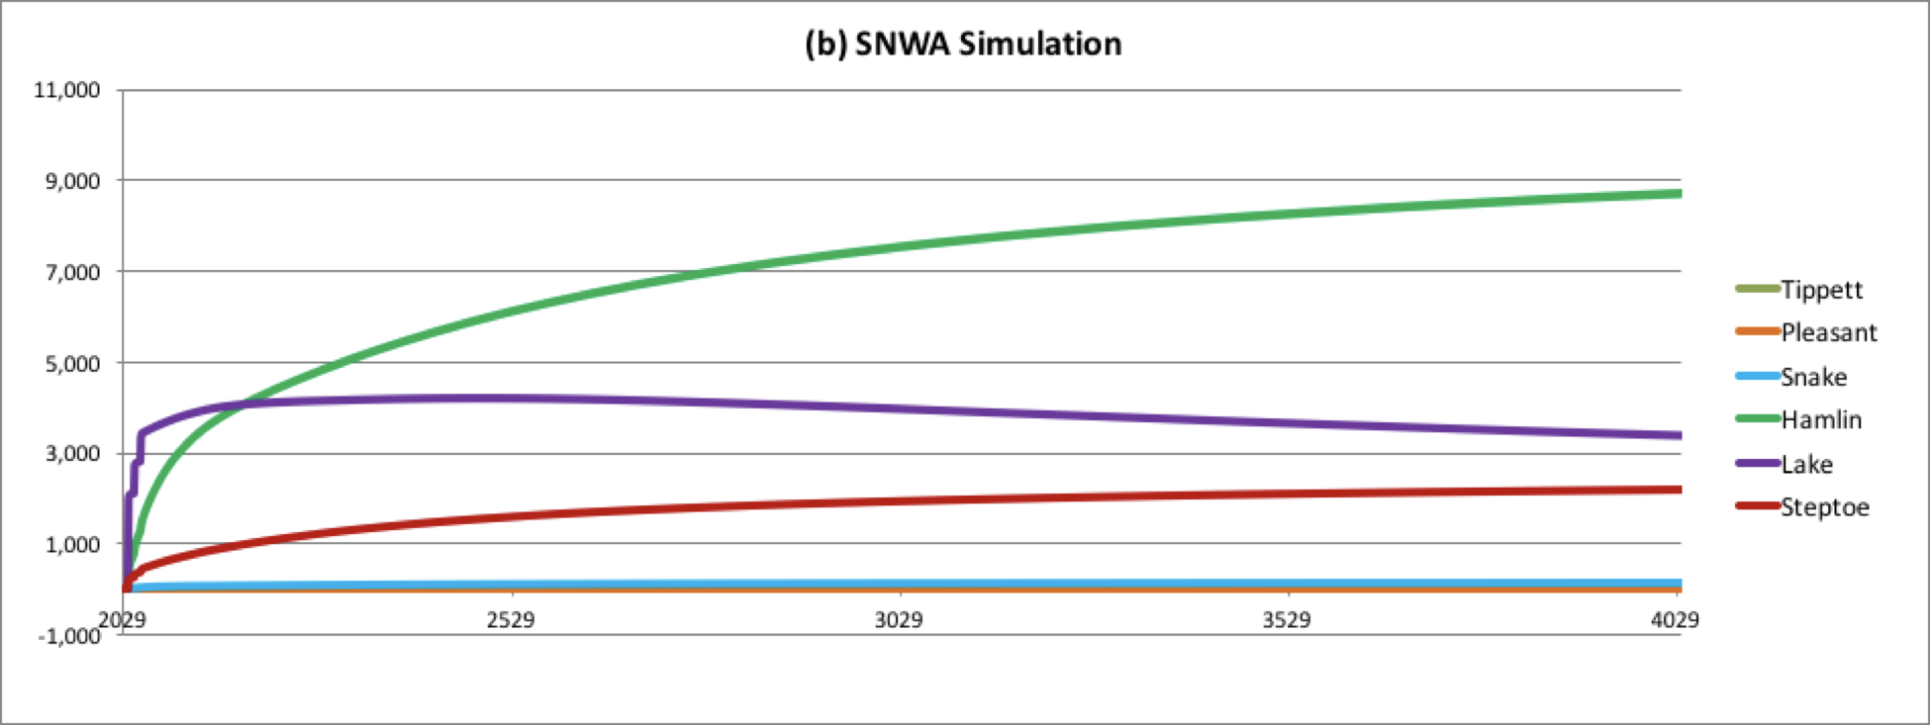
Results - Net Change in Interbasin Flow
CPB Exh 25 - Jones and Mayo, “Response to the June 30, 2017 SNWA Exhibits Related to Spring Valley”, Aug 11, 2017. Aquaveo LLC (pg 10)
“Basin boundary flows are not a component of the perennial yield of Spring Valley. Any outflow to Snake Valley and/or Hamlin Valley is reserved for those basins.” - NSE Ruling 6164, 2012
Notes:
(REVIEW NUMBERS - at 2000 years)
HAMLIN (8844 AFA) (-6734 → 2110)
LAKE (3277 AFA) (-727 → 2550)
Steptoe (2218 AFA) (7781 → 10000)
- SNWA has argued that safe yield should be based solely on a simple water budget analysis. In the context of that debate, we have mainly focused on ET capture. But this slide illustrates that it goes beyond ET capture. If you don’t consider the well locations when approving water allocations, you may end up with a system that draws a substantial amount of water from adjacent basins.
- The change in discharge to adjacent valleys is especially problematic given that the State Engineer specifically stated the following in the Ruling 6164:
(READ STATEMENT)
- Unfortunately, both the CCRP model and basic groundwater hydraulics indicate that the interbasin flow will change in a manner that will harm water users in adjacent valleys and inhibit equilibrium conditions in Spring Valley.

Slide 20
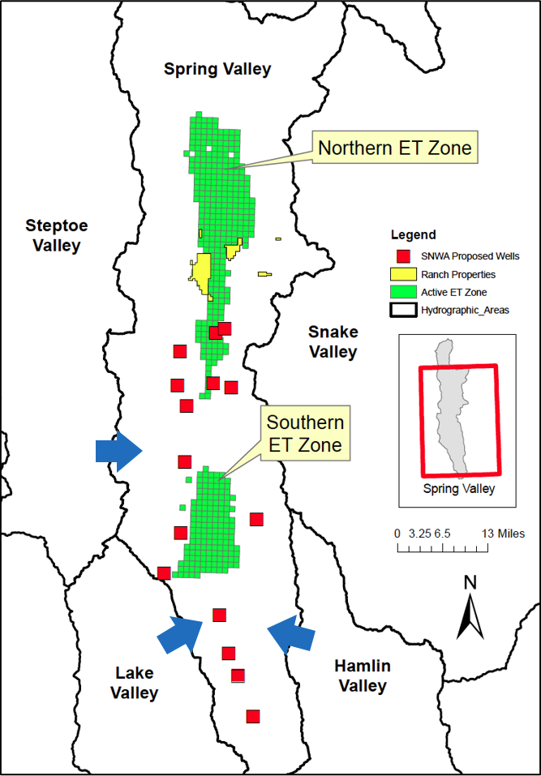
CPB Exh 25 - Jones and Mayo, “Response to the June 30, 2017 SNWA Exhibits Related to Spring Valley”, Aug 11, 2017. Aquaveo LLC (pg 12)
Notes:
- Whenever you do a computer simulation, you need to step back and consider whether the model results make sense from a conceptual point of view. To do this, I would like to refer to this figure from CPB Exh 25.
(DISCUSS MAIN FEATURES OF FIGURE)
- Recall the hypothetical 100-mile long, 1-mile wide hypothetical basin I discussed earlier. This is also large and narrow and suffers from an improperly designed well field that is unable to come to equilibrium.
- The ability of a well field to capture discharge and avoid perpetual GW mining is a function of
- the location of the wells relative to the discharge zones
- the geometry of the basin
- the hydraulic properties of the basin
- In this case, the main ET discharge zone is in the north (70% vs 30%)
- As the aggregate cone of depression grows, it dewaters the southern part of the basin.
- This changes the hydraulic gradients between Spring Valley and adjacent valleys.
- The adjacent valleys are closer to the wells than the main discharge zones.
- Thus, water is mined from adjacent basins and from Spring valley storage and the system never comes to equilibrium.
- This is precisely what we would expect.
- This illustrates why a water balance method is flawed.

Slide 21
Fractional Pumping Analysis
District Court Remand Ruling, Directive #2:
“A recalculation of water available for appropriation from Spring Valley assuring that the basin will reach equilibrium between discharge and recharge in a reasonable time”
Notes:
- Now that we have answered the question of equilibrium, I would like to review a second set of simulations performed that specifically address directive #2 in the remand ruling
(READ THE DIRECTIVE)

Slide 22
Pumping Rates Used in Fractional Analysis
Fraction | Total Pumping [AFA]
10% | 6,108
20% | 12,217
30% | 18,326
40% | 24,501
50% | 30,543
60% | 36,651
70% | 42,760
80% | 48,868
90% | 54,977
100% | 61,085
CPB Exh 25 - Jones and Mayo, “Response to the June 30, 2017 SNWA Exhibits Related to Spring Valley”, Aug 11, 2017. Aquaveo LLC (pg 15)
Notes:
- Having established that the system will never reach equilibrium pumping at the full rate, we used the SNWA CCRP model to determine if there is a reduced appropriation rate that would result in complete ET capture and thereby achieve an equilibrium condition.
- To accomplish this, we took the SNWA model, and proportionally reduced the pumping rate to 90%, 80%, 70%, etc. down to 10% of the 61K AFA value and ran a simulation using each of these values.
- The objective was to plot ET capture vs fractional pumping to facilitate finding a fractional rate at which ET capture is accomplished. In each of these cases, complete ET capture occurs when the net change in ET is equivalent to the fractional pumping rate.
- The pumping rates associated with each fraction are shown in this table

Slide 23
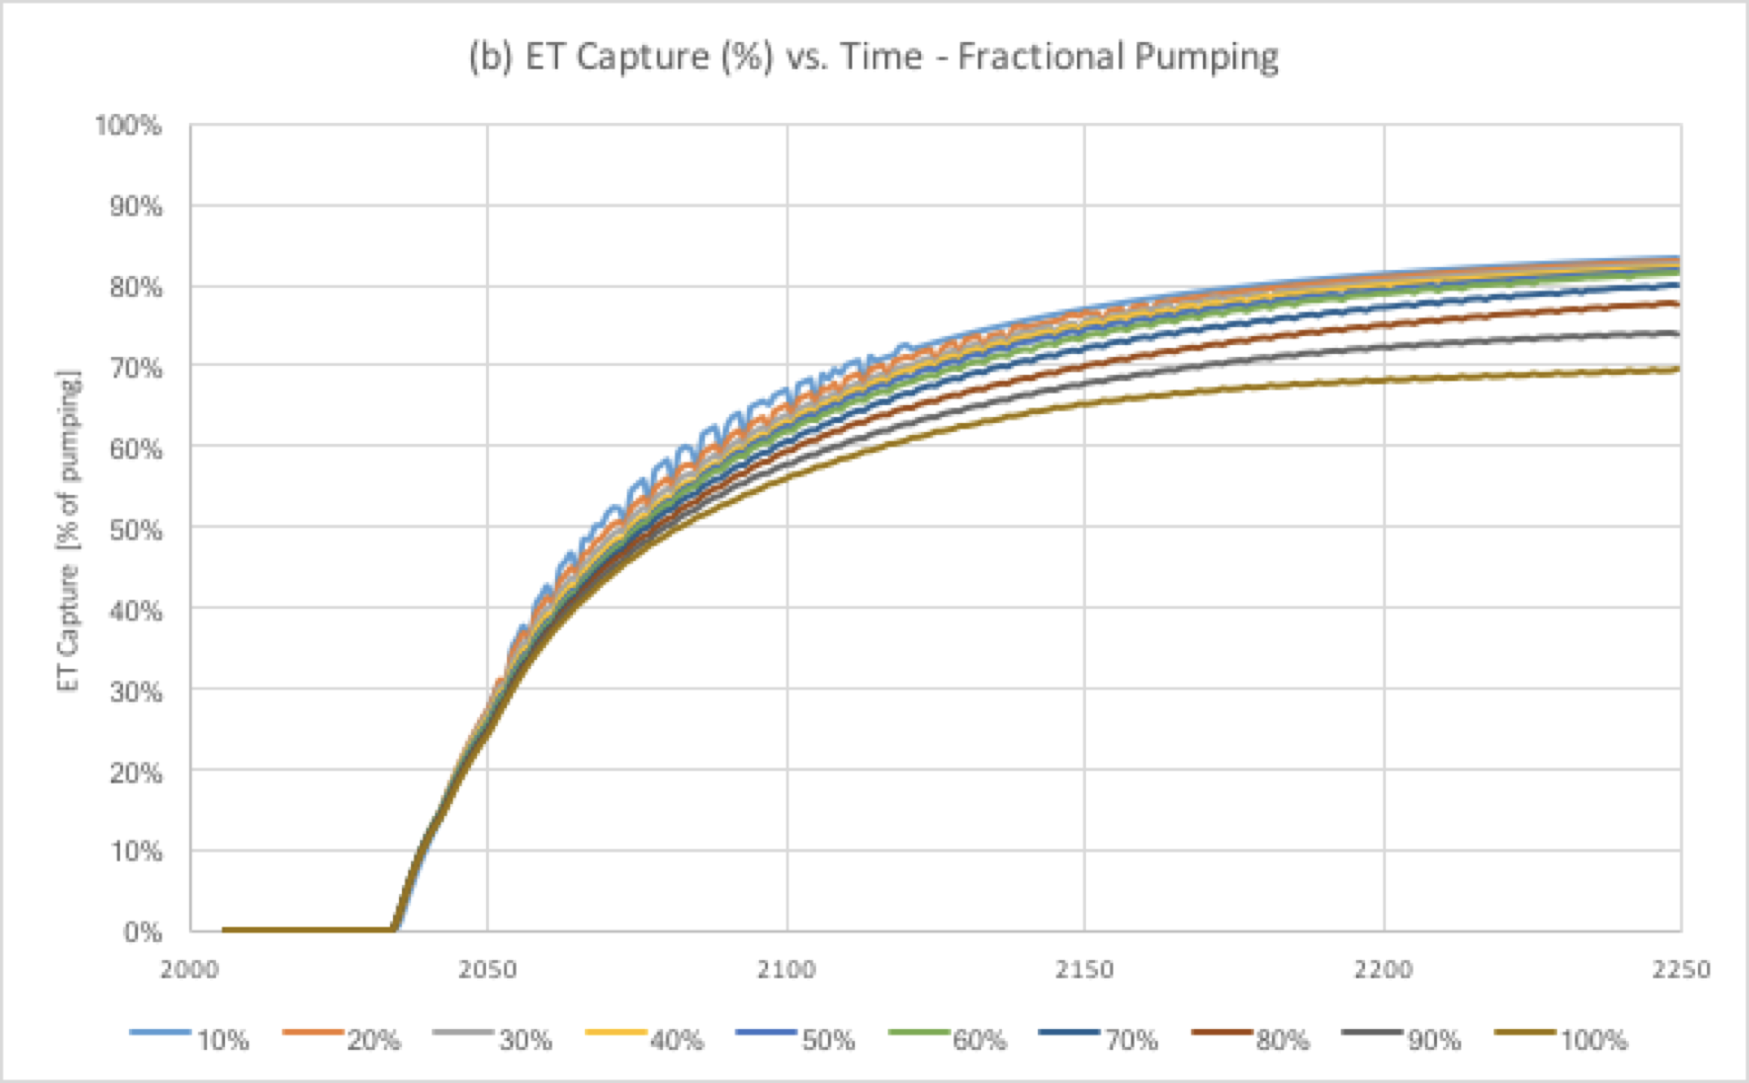
Results - ET Capture (%)
CPB Exh 25 - Jones and Mayo, “Response to the June 30, 2017 SNWA Exhibits Related to Spring Valley”, Aug 11, 2017. Aquaveo LLC (pg 16)
Notes:
- This figure illustrates the ET capture vs time for each of the fractional pumping simulations, normalized to a percentage of the associated fractional pumping rate.
- Complete ET capture would be indicated by one of these curves approaching the 100% line at the top.

Slide 24
“In summary, the SNWA well system is fundamentally flawed due to the spatial distribution of the wells. The wells are located in the central and southern ends of the valley and are not situated inside the ET discharge zones, much of which is in the northern end of the valley. Accordingly, water is mined from storage and pulled from adjacent valleys regardless of the pumping rate. Therefore, there is no reduced appropriation rate that achieves equilibrium and thereby satisfies the directive in the remand ruling.”
CPB Exh 25 - Jones and Mayo, “Response to the June 30, 2017 SNWA Exhibits Related to Spring Valley”, Aug 11, 2017. Aquaveo LLC (pg 21)
Notes:
- Based on these simulations, we came to this conclusion in our report, relative to Remand Ruling #2.
(READ STATEMENT)

Slide 25
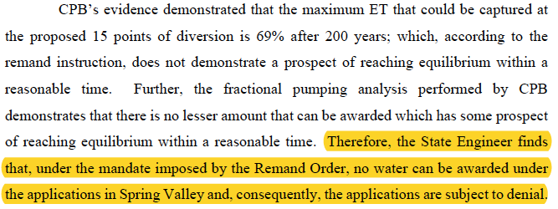
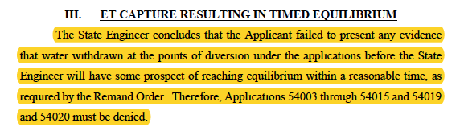
August 2018 State Engineer Ruling

Slide 26
March 2019 - Appeal to District Court
SNWA and the Nevada State Engineer appealed to the 7th District Court to overturn the 2018 Nevada State Engineer ruling by rescinding the 2013 remand ruling which forced the State Engineer to resolve equilibrium/sustainability issues.

Slide 27
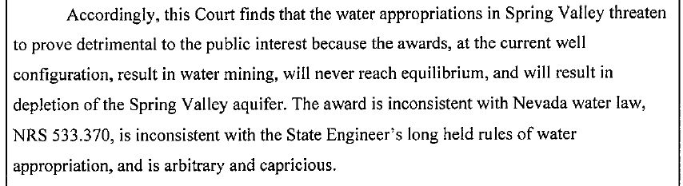
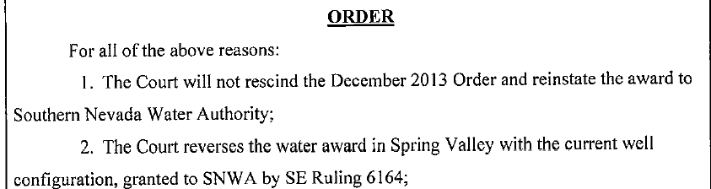
March 2020 - Final District Court Ruling
The SNWA formally abandoned the project a few days after the ruling was announced - 32 years after it had begun.

Slide 28
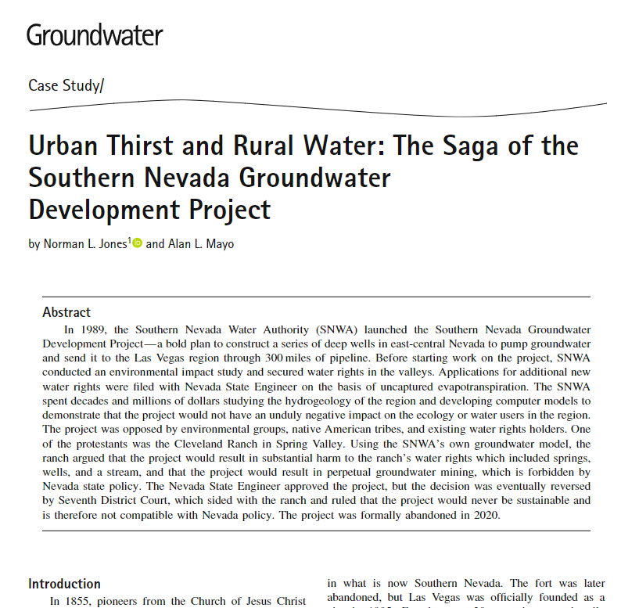
Notes:
https://ngwa.onlinelibrary.wiley.com/doi/epdf/10.1111/gwat.13364

